Slide 1
Background on Network Representation Learning
Presented by Charles Tapley Hoyt
February 12th, 2019
Download from http://bit.ly/background-on-nrl

Slide 2
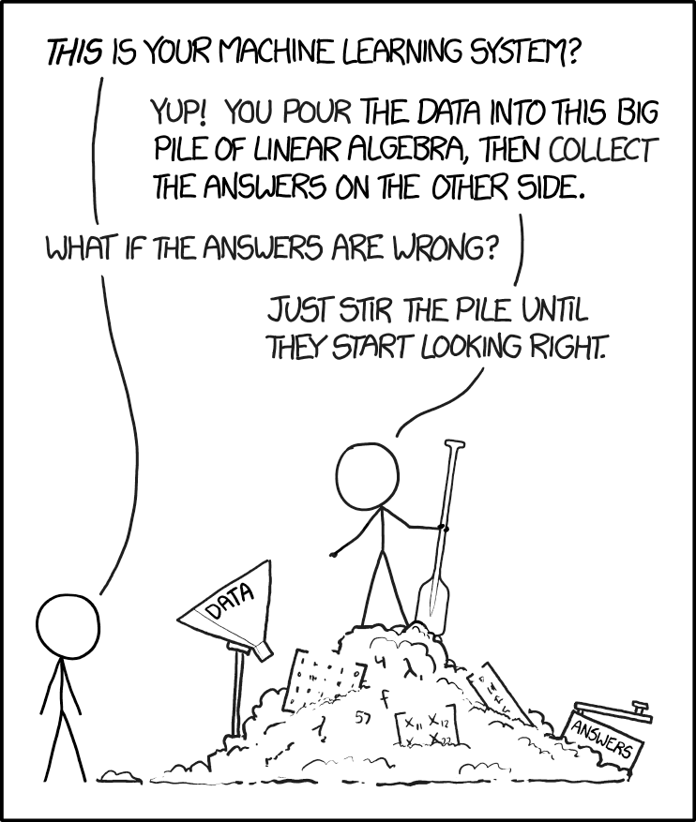
Disclaimer!
Image from https://xkcd.com/1838/

Slide 3
Tasks
Generate dense embeddings for vertices and edges in a directed multigraph G = (V, E)
Solve three main tasks:
Clustering / Downstream Machine Learning Tasks
Link Prediction
Entity Disambiguation

Slide 4
Example Models
Random Walk Models
DeepWalk
Gat2Vec
Node2Vec
Translational Distance Models
Unstructured Model (UM)
Structured Embedding (SE)
TransE
Semantic Matching Models
RESCAL
DistMult
Neural Network Models
EMRLP
ConvE

Slide 5
Random Walk Models

Slide 6
DeepWalk Algorithm [2]
Generate γ random walks starting at each v ∈ V
Train a SkipGram model [1] with window size w and dimension d using vertices as "words" and walks as "sentences"
Recall: SkipGram is a language model that maximizes the co-occurrence probability of words in the same window
Caveat: This model does not generate embeddings for edges

Slide 7
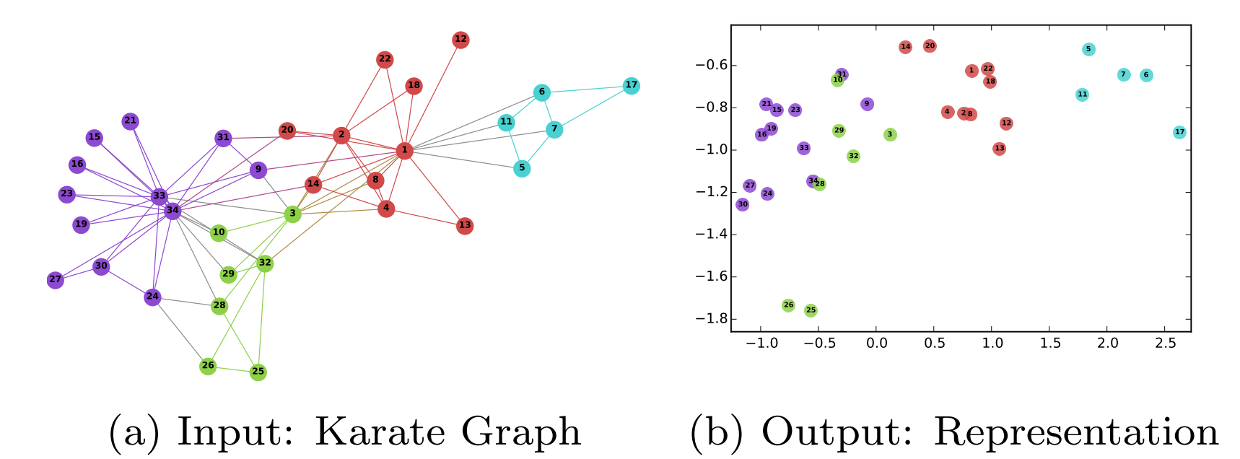
DeepWalk Results
The goal of DeepWalk was to generate embeddings that preserve the community structure in graphs
Obviously useful for clustering
Image from [2] Perozzi et al., (2014)

Slide 8
Gat2Vec Algorithm [3]
Given: an attributed graph G = (V, E, F), attributes A, and attribution function F: V ￫ 2^{A}
Append structural edges {(v, a) | v ∈ V, a ∈ F(v)} to G
Generate γ random walks starting at each v ∈ V
Filter all a ∈ A from the walks
Train a SkipGram model as previously in DeepWalk

Slide 9
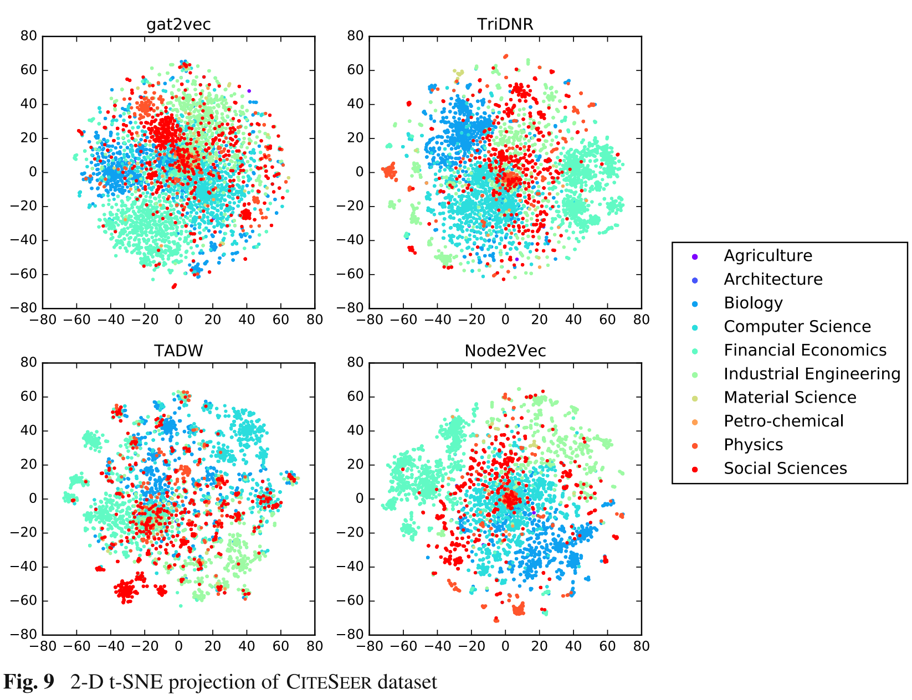
Gat2Vec Results
While Gat2Vec was not more useful than Node2Vec for visualization, made improvements in classification and link prediction tasks in comparison

Slide 10
GuiltyTargets [4]
Annotate a PPI network from HIPPIE (or STRING) with disease-specific differential gene expression
Generate vertex embeddings with Gat2Vec
Train and evaluate a logistic regression classifier using disease-target annotations from OpenTargets (or TDD) as labels
Result: outperformed state-of-the-art approach using topological feature engineering published by Emig et al. [5]

Slide 11
Translational Distance Models

Slide 12
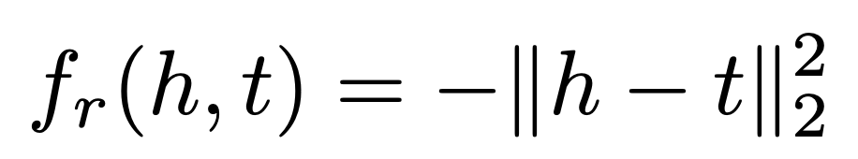
Unstructured Model (UM; 6)
All translation models have negative signs because the loss function maximizes the difference between positive and negative examples
Uses a distance-based scoring function between the head and tail entities that doesn't consider relationship
Best for homogenous graphs

Slide 13
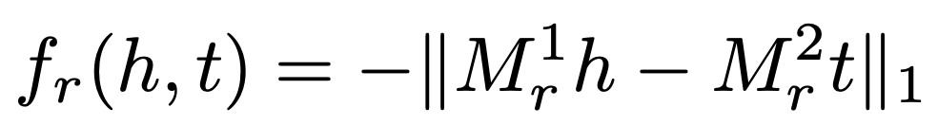
Structured Embedding (SE; 7)
Adds two projection matrices for each relation r
Differentiates the roles of head and tail entities

Slide 14
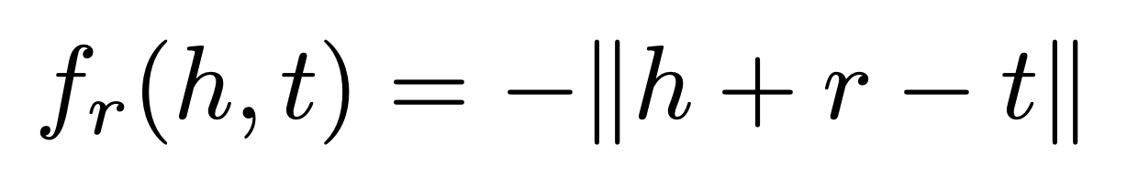
TransE [8]
Model the relation as a direct translation from head to tail entity like: h + r ≈ t
Limited in modeling 1-N, N-1, and N-M relationships. Solved in TransH [9] by representing relationships as hyperplanes.
TransR [10] uses different vector spaces for entities and relations and learns projection matrices jointly
Notes:
TransD adds constraints to TransR to simplify the math

Slide 15
Remarks on Semantic Matching Models
Focus on using similarity-based scoring functions.
RESCAL [11] represents entities with vectors and relations with matrices. DistMult [12] adds constraint that relations should be diagonal matrices
ERMLP [13] uses a multi-layer perceptron
ConvE [14] uses full convolutional neural networks
Notes:
TransD adds constraints to TransR to simplify the math

Slide 16
References
Mikolov, T., et al. (2013). Efficient Estimation of Word Representations in Vector Space, 1–12.
Perozzi, B., et al. (2014). DeepWalk: Online Learning of Social Representations.
Sheikh, N., et al. (2018). Gat2Vec: Representation Learning for Attributed Graphs. Computing, 1–23.
Muslu, Ö., Hoyt, C. T., Hofmann-Apitius, M., & Fröhlich, H. (2019). GuiltyTargets: Prioritization of Novel Therapeutic Targets with Deep Network Representation Learning. BioRxiv, 1–14.
Emig, D., et al. (2013). Drug Target Prediction and Repositioning Using an Integrated Network-Based Approach. PLoS ONE, 8(4).
Bordes, A., et al. (2014) A semantic matching energy function for learning with multi-relational data. Machine Learning 94(2), 233–259
Bordes, A., et al. (2011) Learning structured embeddings of knowledge bases. In: AAAI. vol. 6, p. 6
Bordes, A., et al. (2013) Translating embeddings for modeling multi-relational data. In: Advances in Neural Information Processing Systems. pp. 2787–2795
Wang, Z., et al. (2014) Knowledge graph embedding by translating on hyperplanes. In: AAAI. pp. 1112–1119. Citeseer
Lin, Y., et al. (2015) Learning entity and relation embeddings for knowledge graph completion. In: AAAI. vol. 15, pp. 2181–2187
Nickel, M., et al. (2011) A three-way model for collective learning on multi-relational data. In: ICML. vol. 11, pp. 809–816
Yang, B., et al. (2014) Embedding entities and relations for learning and inference in knowledge bases. arXiv preprint arXiv:1412.6575
Dong, X., et al. (2014) Knowledge vault: A web-scale approach to probabilistic knowledge fusion. In: Proceedings of the 20th ACM SIGKDD International Conference on Knowledge Discovery and Data Mining. pp. 601–610. ACM
Dettmers, T., et al. (2017) Convolutional 2d knowledge graph embeddings. arXiv preprint arXiv:1707.01476

